Slide 1

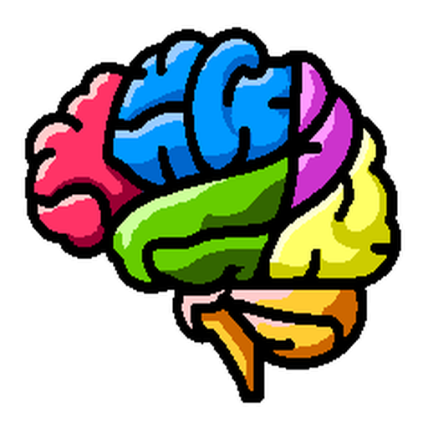
Artificial Intelligence in Biomedical Imaging Lab
(AIBIL – CBICA - UPENN)
NiChart: Neuro Imaging Chart of AI-based Imaging Biomarkers
iSTAGING – NiChart meeting, 02/28/2024

Slide 2
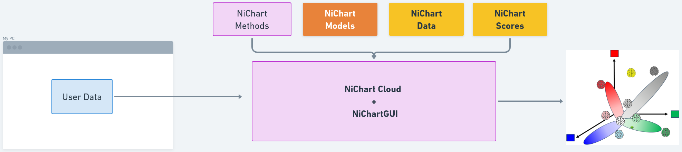
Artificial Intelligence in Biomedical Imaging Lab
(AIBIL – CBICA - UPENN)
NiChart is a framework to:
process multi-modal MRI images,
harmonize to reference data,
apply and contribute machine learning models,
derive individualized biomarkers,
visualize the results
NiChart consists of a set of modular but integrated software tools for neuroimaging research, and a cloud-based web application to provide wide access to these tools.
sMRI
DLICV + DLMUSE pipeline (skullstripping + segmentation)
DLWMLS (white matter lesion segmentation)
sopNMF (multivariate structural analysis
DTI
QSIPrep (BIDS-app methodology for preprocessing & multiple operations)
fMRI
fMRIPrep (task based and rsfMRI preprocessing pipeline using FSL, ANTs, FreeSurfer, and AFNI)
XCPEngine (processing multimodal neuroimages)
pNet (personalized functional network computation and visualization
Harmonization
Combat family of Statistical Harmonization Tools
ML
SPARE
SurrealGAN
SmileGAN
…
Module 1
Image → Features
Module 2
Features → Biomarkers
Module 3
Biomarkers → Visualizations

Slide 3
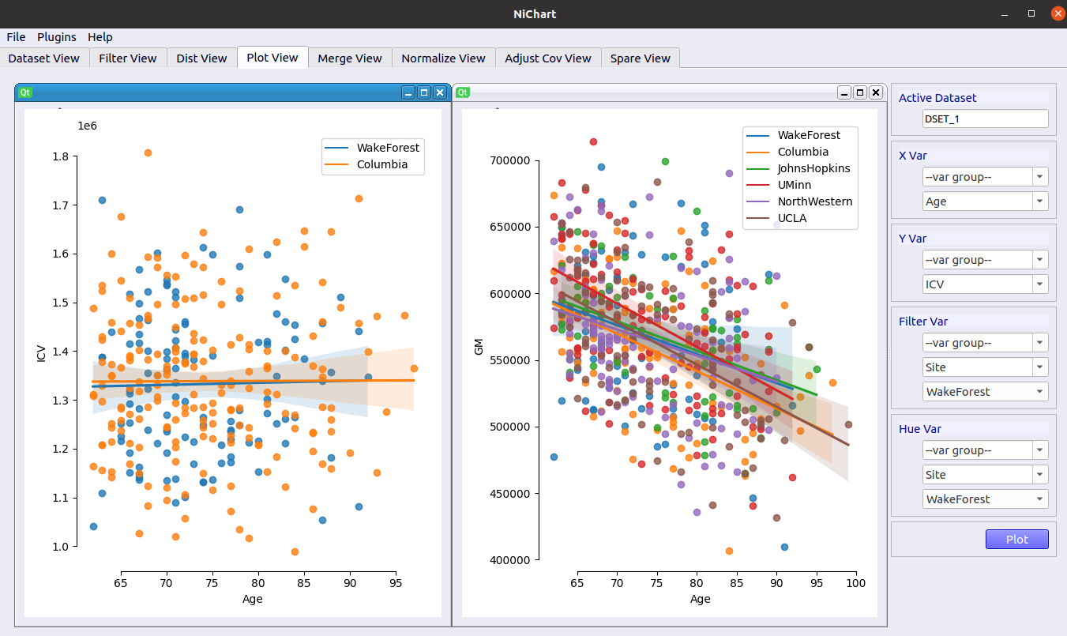
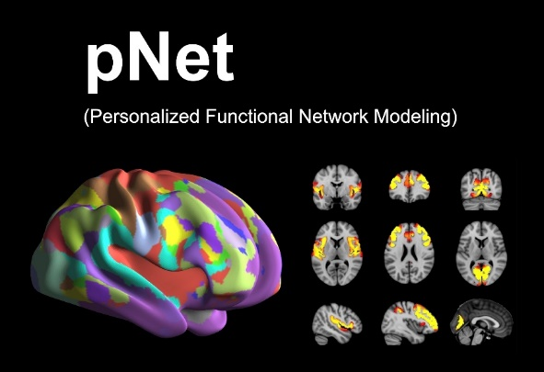
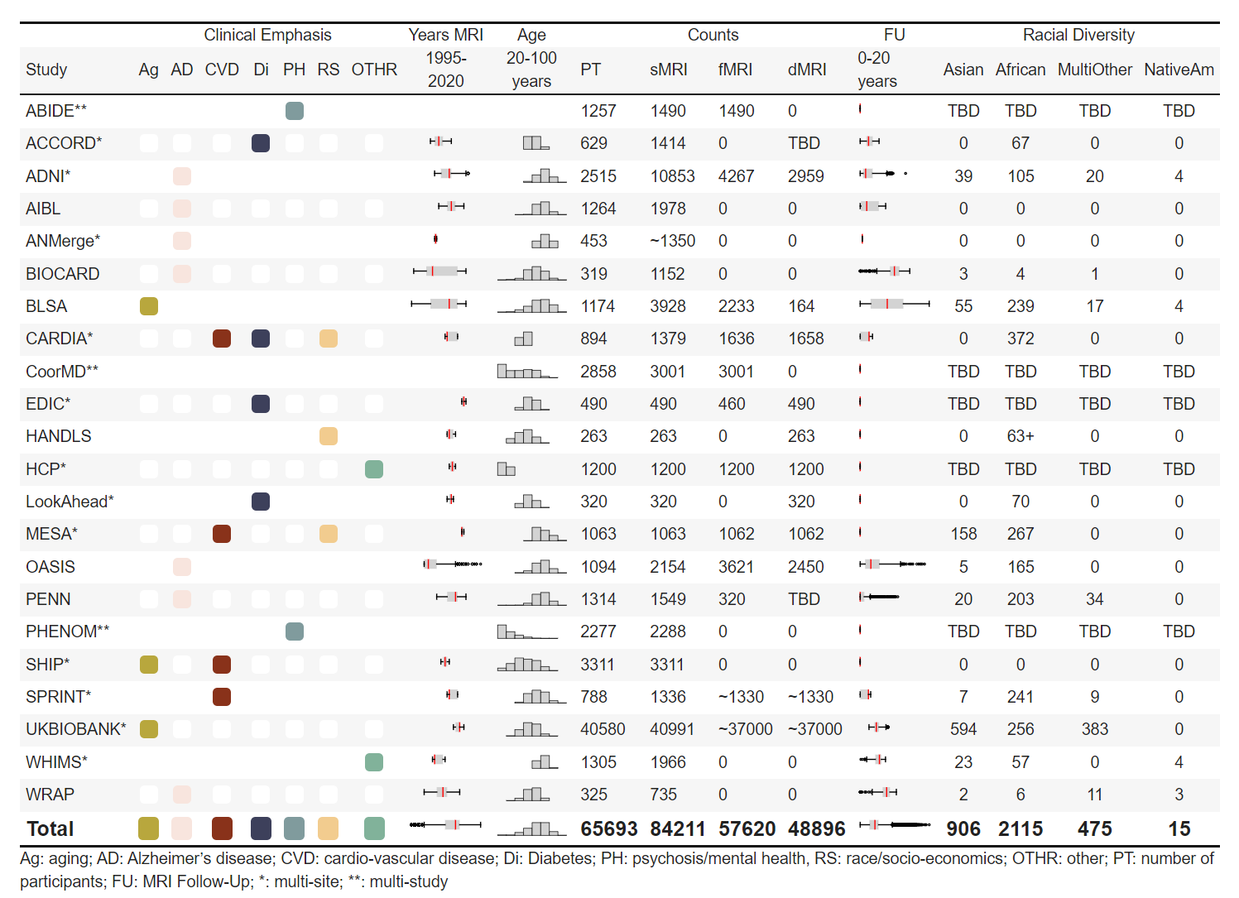
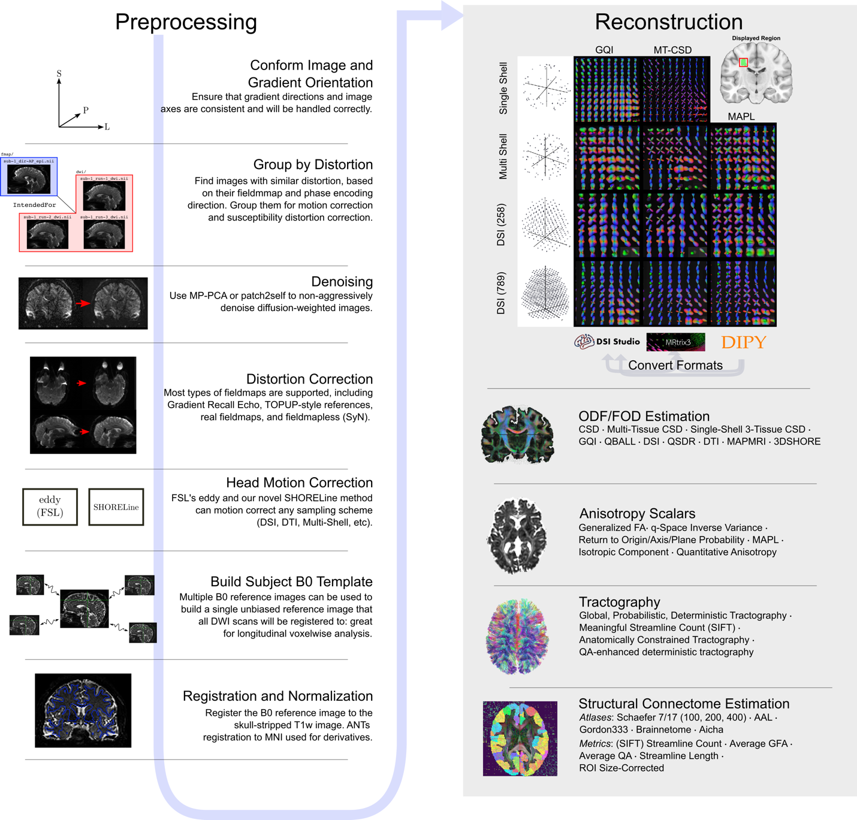
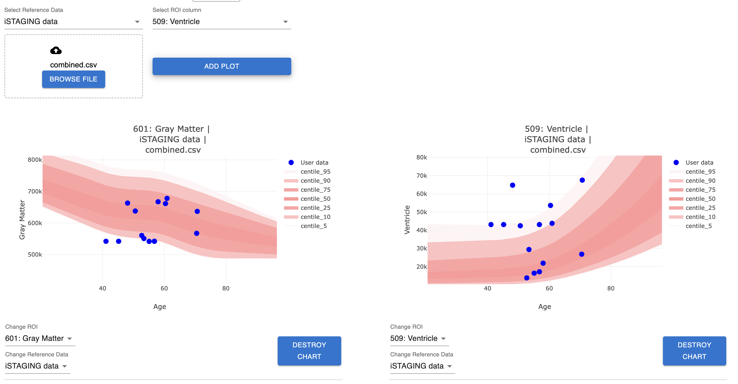
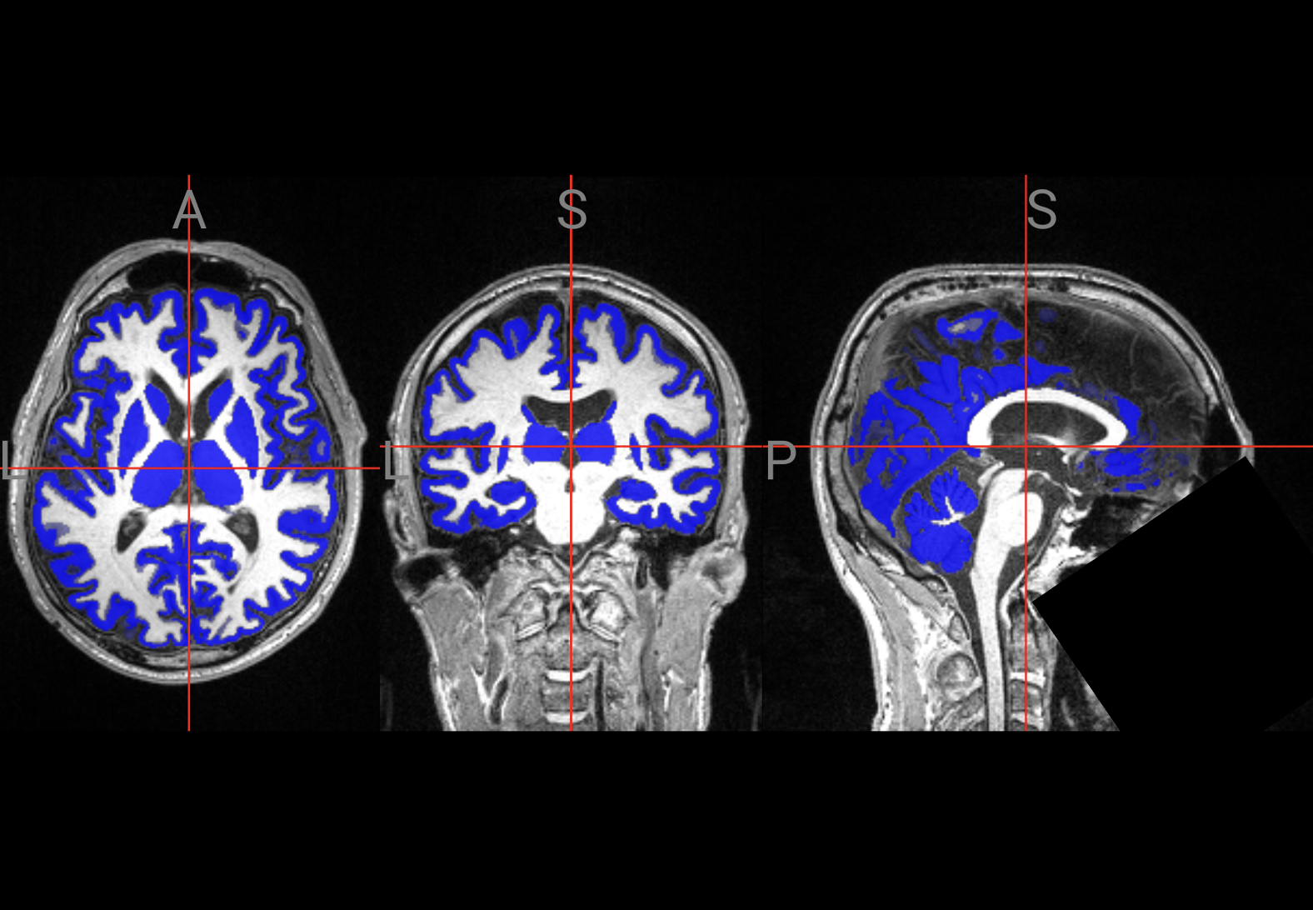
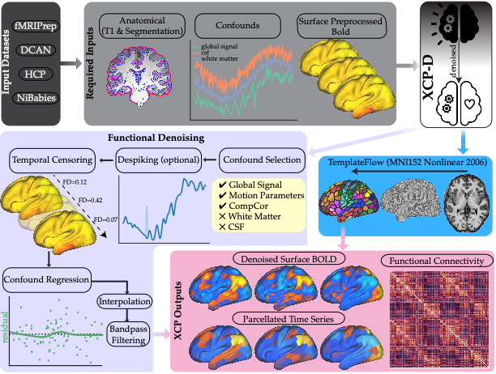
Artificial Intelligence in Biomedical Imaging Lab
(AIBIL – CBICA - UPENN)
Data:
Software:

Slide 4
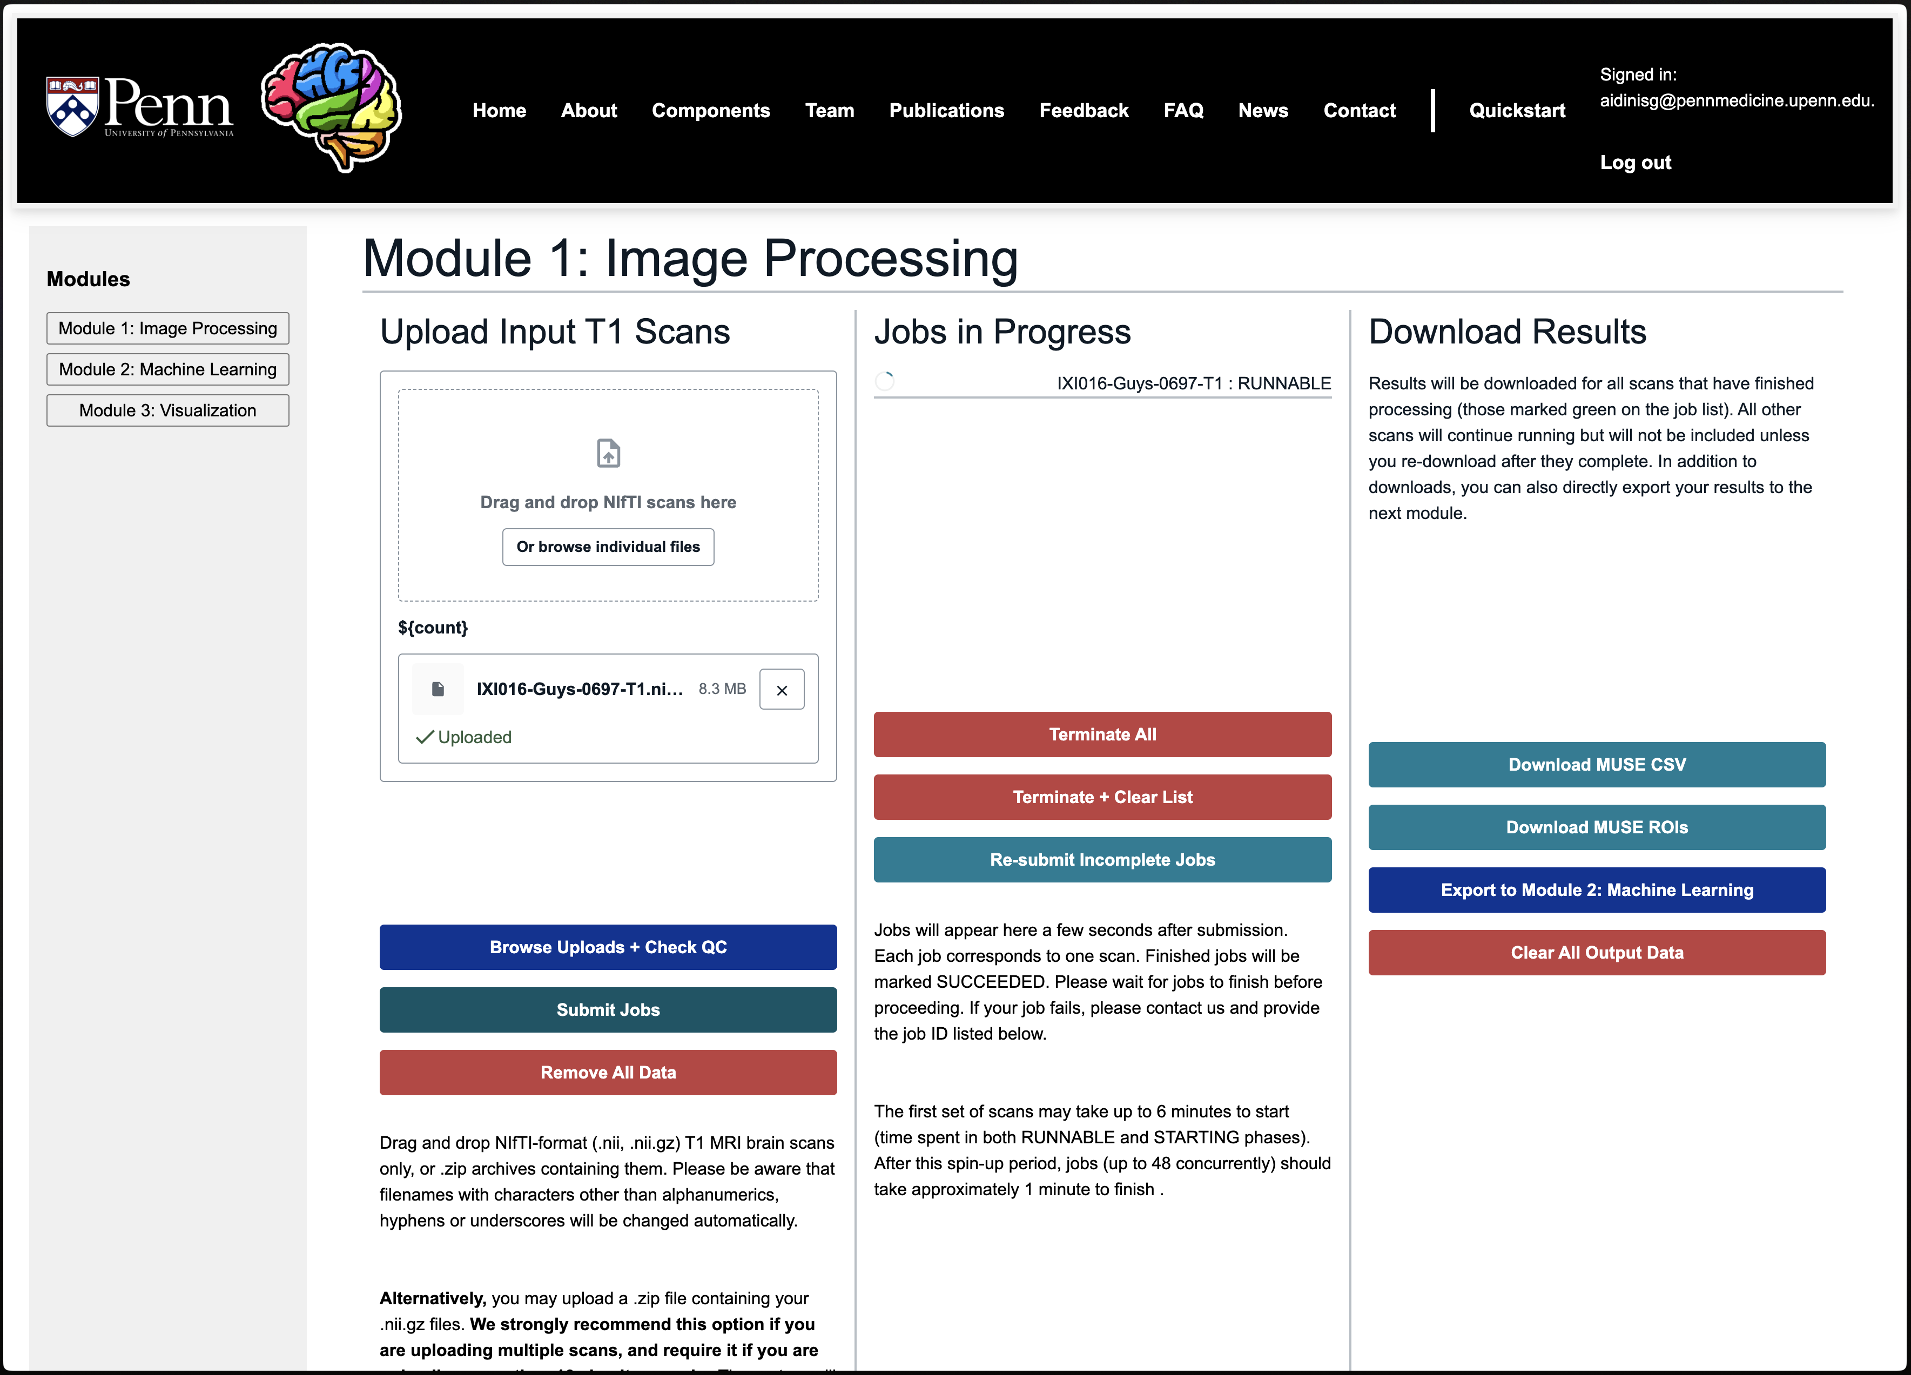
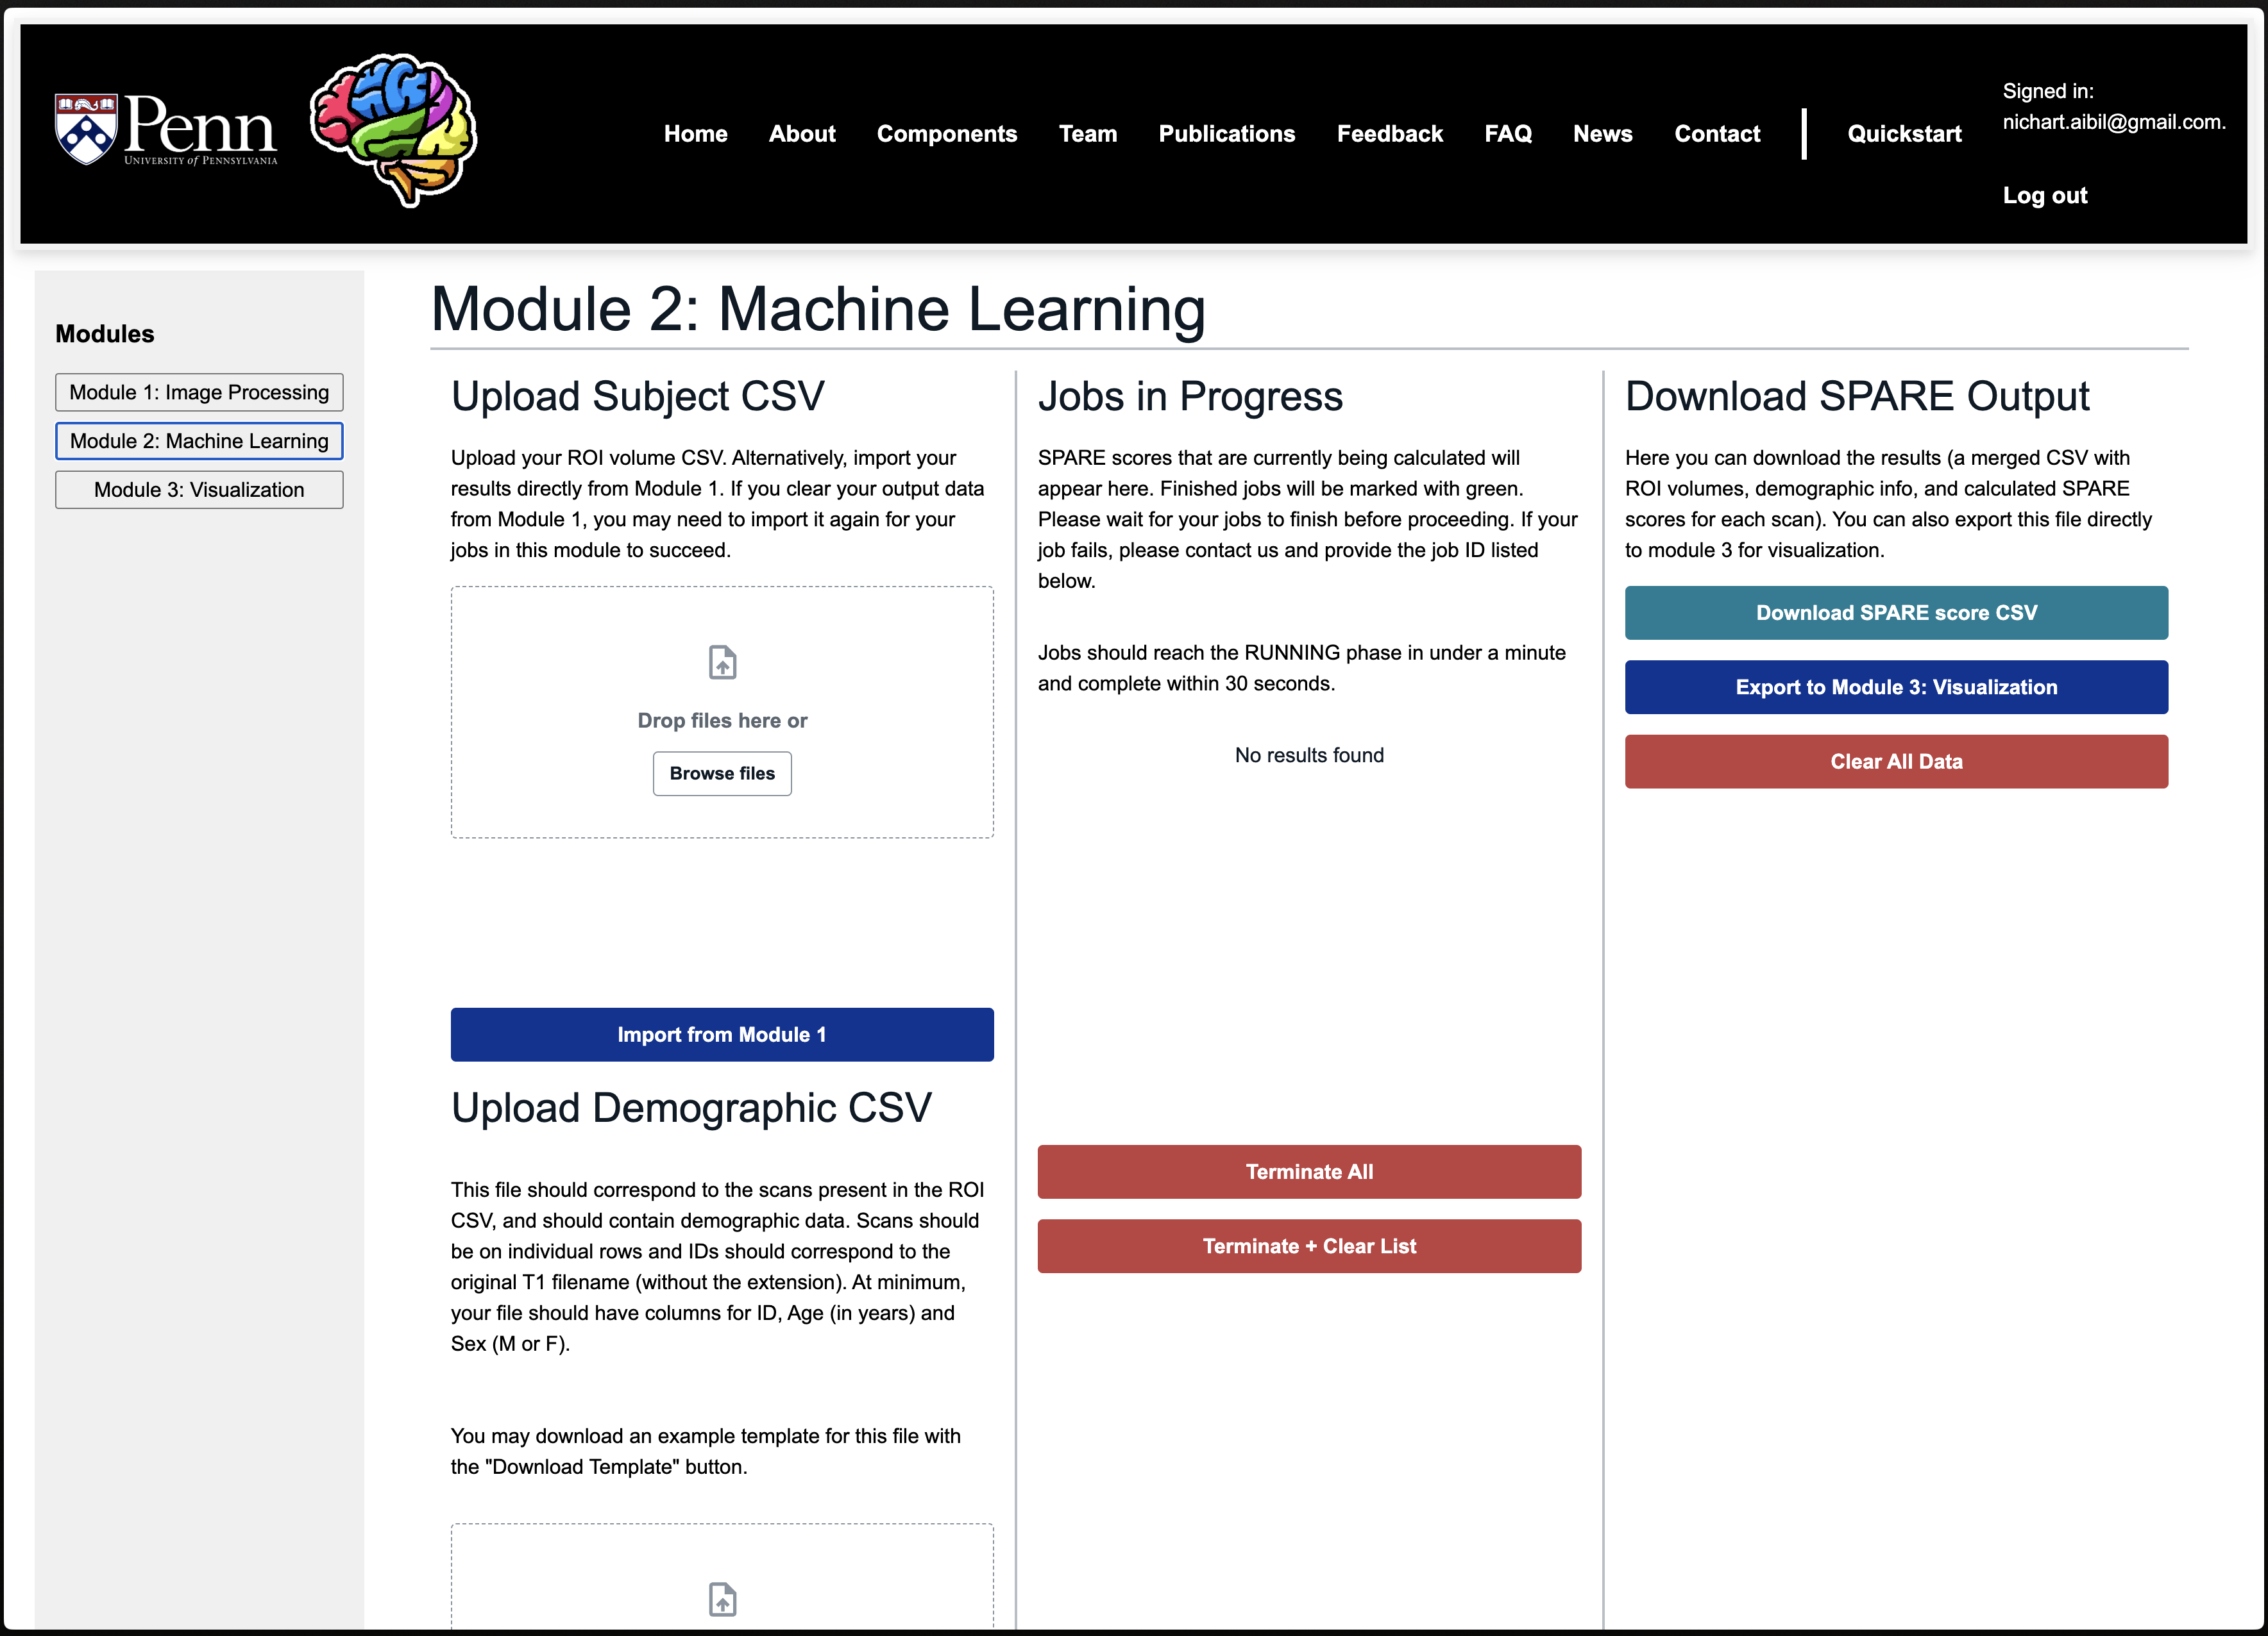
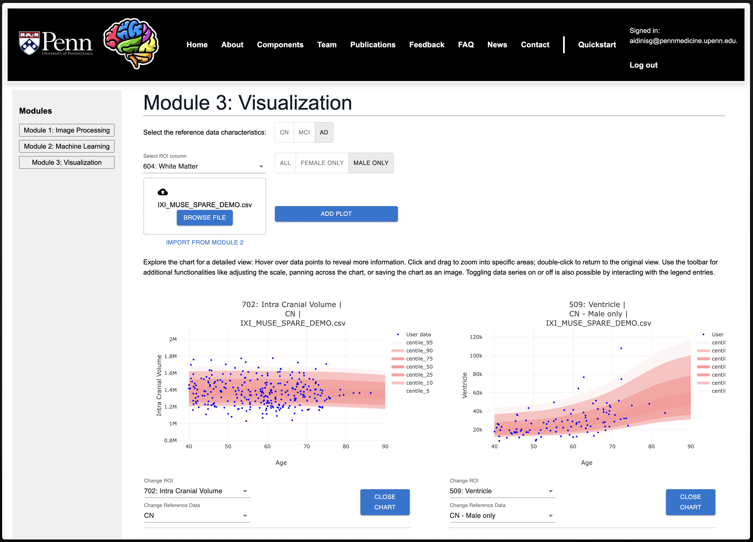
Artificial Intelligence in Biomedical Imaging Lab
(AIBIL – CBICA - UPENN)
Web Portal:
1. Image Processing
2. Machine Learning
3. Visualization

Slide 5
Artificial Intelligence in Biomedical Imaging Lab
(AIBIL – CBICA - UPENN)
[Demo]

